Slide 1
Digital Forensics I:
ECE 387/ CIS 387
File System Analysis:
NTFS Concepts and Analysis

Slide 2
New Technologies File System (NTFS)

Slide 3
NTFS
Default file system for Windows NT, 2000, XP, and Windows Server 2003
No published spec from Microsoft that describes the on-disk layout
Good sources for NTFS information
  Linux NTFS Project
    http://www.linux-ntfs.org/doku.php
  www.ntfs.com
Notes:
NTFS was developed in collaboration of Microsoft and IBM in an attempt to build a competitive OS (windows NT).
-ultimately it failed to be successful/competitive; but IBM and Microsoft continue with their own version of the NTFS project, with Windows retaining the name of the original project (NTFS).

Slide 4
NTFS
NTFS was designed for
  Reliability,
  Security
  Scalability.
Scalability is provided by the use of generic data structures that wrap around data structures with specific content.
  This is a scalable design because the internal data structure can change over time as new demands are placed on the file system, and the general wrapper can remain constant.
    e.g. a generic wrapper in which every byte of data in an NTFS file system is allocated to a file

Slide 5
Everything is a File
An NTFS file system does not have a specific layout like other file systems, e.g., FAT.
  The entire file system is considered a data area, and any sector can be allocated to a file.
The only consistent layout is that the first sectors of the volume contain the boot sector and boot code.
Notes:
One of the most important concepts in understanding the design of NTFS is that important data are allocated to files. This includes the basic file system administrative data that are typically hidden by other file systems. In fact, the files that contain the administrative data can be located anywhere in the volume, like a normal file can.
$boot is a special file (not considered a boot sector like in FAT).

Slide 6
Master File Table (MFT)
Contains information about all files and directories
Every file and directory has at least one entry in the table
Each entry is simple
  Size: 1 KB
  Entry header is first 42 bytes
  Remaining bytes store attributes

Slide 7
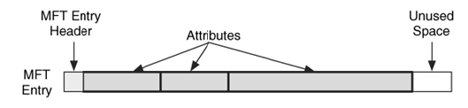
MFT Concepts
The Master File Table (MFT) is the heart of NTFS.
It contains the information about all files and directories.
Every file and directory has at least one entry in the table, and the entries by themselves are very simple.
They are 1 KB in size, BUT
  only the first 42 bytes have a defined purpose.
  the remaining bytes store attributes (file name, data, etc.), which are small data structures that have a very specific purpose.
    For example, one attribute is used to store the file's name, and another is used to store the file's content.
    Figure below shows the basic layout of an MFT entry where there is some header information and three attributes.
Notes:
Advantage of this setup since almost the entire entry is the data area is that even for very small files you do not need to use so much space (since meta data → default header data takes up space); now, if a file is very small (like cookie files), it can simply be stored in the attribute area since you have free reign on what structure make up the attribute areas.

Slide 8
MFT Properties
Microsoft calls each entry in the table a file record, but calling each entry an MFT entry is simpler.
Each entry is given an address based on its location in the table, starting with 0.
To date, all entries have been 1,024 bytes in size, but the exact size is defined in the boot sector.

Slide 9
MFT Properties: The MFT is a file
The MFT has an entry for itself.
The first entry in the table is named $MFT, and it describes the on-disk location of the MFT. ($MFTMirr = backs up first 4 entries (4KB) of MFT table, which are the 4 most important entries)
In fact, it is the only place where the location of the MFT is described; therefore, you need to process it to determine the layout and size of the MFT.
The starting location of the MFT is given in the boot sector ($boot), which is always located in the first sector of the file system.
Consider, for example, the case where the MFT is fragmented and goes from clusters 32 to 34 and 56 to 58.
The boot sector is used to find the first MFT entry.
Notes:
If a file starts with a dollar sign ($), it means that a file is a system file (hidden from normal users).
Remember: each partition could use a different file system (e.g., volume 1 using FAT, volume 2 using NTFS, volume 3 using EXT).

Slide 10
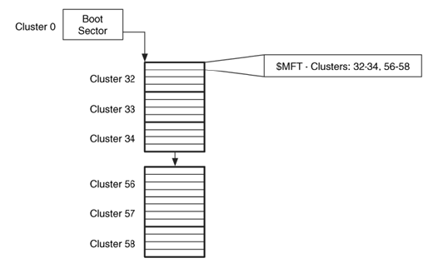
Notes:
Typically we try to avoid fragmenting the MFT Table by allocating enough space for initial MFT table size so we do not have to add space (and thus fragment) in the future.

Slide 11
MFT Properties
Like FAT, NTFS also uses clusters, groups of consecutive sectors, for data storage.
In Microsoft's implementation of NTFS, the MFT starts as small as possible and expands when more entries are needed.
In theory, however, an OS could create a fixed number of entries when the file system is created, but the dynamic nature of Microsoft's implementation allows it to easily make the file system larger when more space is added from volume spanning.
Microsoft does not delete MFT entries after they have been created.
Notes:
You can make MFT get bigger, but not smaller! (you either allocate clusters by overwrite deleted MFT entries, or if you need more space then you fragment and allocate more clusters and overwrite non-MFT entry space).

Slide 12
MFT Entry Contents
Size: The size of each MFT entry is defined in the boot sector, but all versions from Microsoft have used a size of 1,024 bytes.
Layout: The first 42 bytes of the data structure contain 12 fields, and the remaining 982 bytes are unstructured and can be filled with attributes.

Slide 13
MFT Entry Contents: Example
  Imagine an MFT entry as a large box that is used to store your possessions.
    It can be used to store anything as long as it is in a container that is smaller than the box. This is similar to how an MFT entry has no internal structure and it contains several attributes that contain specific information.
  On the outside of the box is basic information, such as owner's name and address.
    This is equivalent to an MFT entry's fixed fields.

Slide 14
MFT Entry Contents: Layout
The first field in each MFT entry is the signature,
  A standard field entry will have the ASCII string "FILE." or string "BAAD“ of an error is found in the entry.
There is also a flag field that identifies if the entry is being used and if the entry is for a directory.
The allocation status of an MFT entry can also be to determined from the $BITMAP attribute in the $MFT file.
What if a file cannot fit its attributes into one entry?
  it can use multiple entries.
  When this occurs, the first entry is called the base file record, or base MFT entry, and each of the subsequent entries contains the address of the base entry in one of its fixed fields.

Slide 15
MFT Entry Addresses
Each MFT entry is sequentially addressed using a 48-bit value,
  the first entry has an address of 0.
The maximum MFT address changes as the MFT grows which is given as,
MFT address change = (size of $MFT) / (size of each entry)
  Microsoft calls this sequential address the file number.
Notes:
Thus you can have 2^48 entries at maximum (of course, that many entries is never used).
Example, if MFT allocated size = 4MB, and each entry is 1KB, then you can have 4MB/4KB = 4,000 entries possible.

Slide 16
MFT Entry Addresses
Every MFT entry also has a 16-bit sequence number that is incremented when the entry is allocated.
Example,
  Consider MFT entry 313 with a sequence number of 1.
  Assume that the file associated to entry 313 is deleted, and the entry is reallocated to a new file. When the entry is reallocated, it has a new sequence number of 2.
  The MFT entry and sequence number are combined, with the sequence number in the upper 16-bits, to form a 64-bit file reference address, shown in the next slide.
Notes:
Sequence number increments by 1 every time a new file is allocated at the same entry as an old/deleted file that previously was allocated that file.

Slide 17
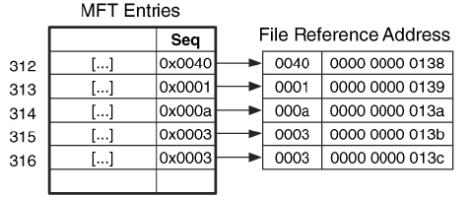
File Reference Address: Example
Notes:
First 16 bites is file sequence numbers.
Remember MFT entry is 48 bits, and then there is an additional 16 bits for sequence numbers.
To get File Reference Address → simply reverse the 48 bits and 16 bits such that Reference Addr(64 bit address) = sequence Number (upper 16 BITS) + MFT entry (lower 48 bits).
-NOTICE: File reference address is the reverse of MFT address + sequence number → sequence number + MFT address

Slide 18
File Reference Address: Applications
To access MFT entries of corrupt file system: NTFS uses the file reference address to refer to MFT entries because the sequence number makes it easier to determine when the file system is in a corrupt state.
  For example, if the system crashes at some point while the various data structures for a file are being allocated, the sequence number can determine whether a data structure contains an MFT entry address because the previous file used it or because it is part of the new file.
To recover deleted content: We also can use it when recovering deleted content. For example, if we have an unallocated data structure with a file reference number in it, we can determine if the MFT entry has been reallocated since this data structure used it.
To investigate: The sequence number can be useful during an investigation.

Slide 19
File System Metadata Files
In NTFS file system, every byte in the volume is allocated to a file, therefore, how to find the file system's administrative data or metadata files (according to Microsoft).
  Microsoft documentation says it reserves only the first 16 entries, but in practice the first entry that is allocated to a user file or directory is entry 24. Entries 17 to 23 are sometimes used as overflow when the reserved entries are not enough.
Microsoft reserves the first 16 MFT entries for file system metadata files.
These reserved and unused entries are in an allocated state and have only basic and generic information.
Every file system metadata file is listed in the root directory, although they are typically hidden from most users.
The name of each file system metadata file begins with a "$," and the first letter is capitalized.

Slide 20
The standard NTFS file system metadata files.
Entry | File Name | Description
0 | $MFT | The entry for the MFT itself.
1 | $MFTMirr | Contains a backup of the first entries in the MFT.
2 | $LogFile | Contains the journal that records the metadata transactions.
3 | $Volume | Contains the volume information such as the label, identifier, and version.
4 | $AttrDef | Contains the attribute information, such as the identifier values, name, and sizes.
5 | . | Contains the root directory of the file system.
6 | $Bitmap | Contains the allocation status of each cluster in the file system.
7 | $Boot | Contains the boot sector and boot code for the file system.
8 | $BadClus | Contains the clusters that have bad sectors.
9 | $Secure | Contains information about the security and access control for the files (Windows 2000 and XP version only).
10 | $Upcase | Contains the uppercase version of every Unicode character.
11 | $Extend | A directory that contains files for optional extensions. Microsoft does not typically place the files in this directory into the reserved MFT entries.

Slide 21
Example
The istat tool from The Sleuth Kit (TSK) can be used for file system metadata analysis.
# istat –f ntfs ntfs1.dd 0
[REMOVED]
$STANDARD_INFORMATION Attribute Values: Flags: Hidden,
System Owner ID: 0 Security ID: 256
Created: Thu Jun 26 10:17:57 2003
File Modified: Thu Jun 26 10:17:57 2003
MFT Modified: Thu Jun 26 10:17:57 2003
Accessed: Thu Jun 26 10:17:57 2003
[REMOVED]
Attributes:
Type: $STANDARD_INFORMATION (16-0) Name: N/A Resident size: 72
Type: $FILE_NAME (48-3) Name: N/A Resident size: 74
Type: $DATA (128-1) Name: $Data Non-Resident size: 8634368
342709 342710 342711 342712 342713 342714 342715 342716 342717 342718 342719 342720
342721 342722 342723 342724
[REMOVED]
443956 443957 443958 443959 443960 443961 443962 443963
Type: $BITMAP (176-5) Name: N/A Non-Resident size: 1056 342708 414477 414478 414479
Notes:
Notice there are 4 time stamp entries.
Remember: the entire disk space is the data area, which is split into attributes, with minimum size of a file at 1024KB. Note: if you have small file, you can fit the meta data attributes and data into 1KB if the file is small enough (thus you can fit data into “Resident part of a file”). If too large, you need to place data as extending into “non-resident area” – thus you need to allocate at least a cluster for the file if data is large enough. With FAT, remember, you need 32KB (1 cluster) no matter how small the file is.
Inside $BITMAP file system (system file) attribute, there is a bitmap that can be used to say whether a cluster is allocated or not → if you have 1 million clusters, you would need 1 million bits for the cluster bitmap.
$MFT contains 1KB entry for each file for start cluster for each file (unless file is small enough to be resident and fit inside of the MFT entry)
Bitmap (this is separate from the $BITMAP system file!) attribute in the $MFT file (which is 4KB) tells whether each entry is allocated or not; if you have 100,000 entries, you need 100,000 bits for a bitmap.
Each file has usually these 3 attributes: standard information, file name, and data.

Slide 22
$MFTMirr File Overview
As the $MFT file is used to find all other files, therefore, it has the potential of being a single point of failure if the pointer in the boot sector or the $MFT entry is corrupt.
To fix this problem, there exists a backup copy of the important MFT entries that can be used during recovery.
MFT entry 1 is for the $MFTMirr file, which has a non-resident attribute that contains a backup copy of the first MFT entries.
The $DATA attribute of the $MFTMirr file allocates clusters in the middle of the file system and saves copies of at least the first four MFT entries, which are for $MFT, $MFTMirr, $LogFile, and $Volume.

Slide 23
$MFTMirr File Overview
If there are problems determining the layout of the MFT, a recovery tool can use the volume size to calculate where the middle sector of the file system is located and read the backup data.
Each MFT entry has a signature that can be used to verify that it is an MFT entry.
The recovery tool can use these four backup entries determine the MFT
  layout and size,
  the location of the $LogFile so that the file system can be recovered, and
  the version and status information from the $Volume attributes.

Slide 24
$MFTMirr File Overview: Example
The details of the $MFTMirr file from our example image are shown here:
# istat –f ntfs ntfs1.dd 1
[REMOVED]
Attributes:
Type: $STANDARD_INFORMATION (16-0) Name: N/A Resident size: 72
Type: $FILE_NAME (48-2) Name: N/A Resident size: 82
Type: $DATA (128-1) Name: $Data Non-Resident size: 4096
514064 514065 514066 514067

Slide 25
$Boot File Overview
The $Boot file system metadata file is located in MFT entry 7.
It contains the boot sector of the file system.
This is the only file system metadata file that has a static location.
Its $DATA attribute is always located in the first sector of the file system because it is needed to boot the system.
Microsoft typically allocates the first 16 sectors of the file system to $Boot, but only the first half has non-zero data.
The NTFS boot sector is very similar to the FAT boot sector, and they share many fields, e.g., share the 0xAA55 (little Indian order; if normal order signature displays as 0x55AA) signature.
The boot sector gives you basic size information about the size of each cluster, the number of sectors in the file system, the starting cluster address of the MFT, and the size of each MFT entry.
The boot sector also gives a serial number for the file system.

Slide 26
$Boot File Overview
The remainder of the sectors allocated to the $Boot file's $DATA attribute are used for boot code.
The boot code is essential only on bootable file systems and locates the files needed to load the operating system.
A backup copy of the boot sector exists in either the last sector of the volume or in the middle of the volume.
It has been observed that the total number of sectors in the file system is less than the total number of sectors in the volume, so the backup copy of the boot sector did not have to be allocated to a specific file.
Example:
Consider the previous example of file system image,
  the volume has 2,056,257 sectors, and the boot sector reports 2,056,256 sectors in the file system.
  The final sector in the volume that is not allocated to the file system contains the backup copy of the boot sector.
Notes:
$Boot file always found in first sector a volume (or disk if disk only has 1 partition).
Also contains the location of the $MFT file.
Backup boot sector is located at the end of the volume at the very last sector.

Slide 27
$Boot File Overview: Example
To show the attribute details of what a $Boot file looks like, the output from running istat on our example image is shown here:
# istat –f ntfs ntfs1.dd 7
[REMOVED]
Attributes:
Type: $STANDARD_INFORMATION (16-0) Name: N/A Resident size: 48
Type: $FILE_NAME (48-2) Name: N/A Resident size: 76
Type: $SECURITY_DESCRIPTOR (80-3) Name: N/A Resident size: 104
Type: $DATA (128-1) Name: $Data Non-Resident size: 8192
0 1 2 3 4 5 6 7
The bottom lines show that it has four attributes, including the $DATA attribute that is 8 KB in size and has allocated clusters 0 to 7.
Notes:
Remember: $Boot File is VERY FIRST FILE of the volume!
BUT: its file ID is 7, not 0.
Note above: the $ALL CAPS are referring to file attribute types; in parenthesis (##-#), the ## refers to attribute TYPE, the second number # refers to location of attribute relative to the MFT entry; for example using the above: the first entry is of type STANADARD INFORMATION (16) and is the first attribute (attribute 0) → then the second attribute of the MFT entry is of type DATA (128) and is the second attribute (attribute 1) of the MFT entry.
note: you can have more than one of the same type, the $TYPE_NAME can be changed to whatever you desire, it is the type ## identifier than defines the type.

Slide 28
$Volume File Overview
The $Volume file system metadata file is located in MFT entry 3
It contains the volume label and other version information.
It has two unique attributes that no other file is supposed to have.
  The $VOLUME_NAME attribute contains the Unicode name of the volume, and
  the $VOLUME_INFORMATION attribute contains the NTFS version and dirty status.
In addition to these attributes, the file typically has a $DATA attribute, but I have found that it has a size of 0 bytes (thus; we can keep the entire $volume file as resident → stored inside 1KB MFT entry.
The NTFS file system has had minor changes for each new major release of Windows, and the version number can be found in this file.
  For example,
  Windows NT 4.0 had version 1.2, Windows 2000 had version 3.0, and Windows XP had version 3.1. The differences among versions are minor, and the same general data structures apply to all of them.

Slide 29
$Volume File Overview: Example
The attribute details of the $Volume file in our example image are shown here:
# istat -f ntfs ntfs1.dd 3
[REMOVED]
Attributes:
Type: $STANDARD_INFORMATION (16-0) Name: N/A Resident size: 48
Type: $FILE_NAME (48-1) Name: N/A Resident size: 80
Type: $OBJECT_ID (64-6) Name: N/A Resident size: 16
Type: $SECURITY_DESCRIPTOR (80-2) Name: N/A Resident size: 104
Type: $VOLUME_NAME (96-4) Name: N/A Resident size: 22
Type: $VOLUME_INFORMATION (112-5) Name: N/A Resident size: 12
Type: $DATA (128-3) Name: $Data Resident size: 0
The $VOLUME_NAME and $VOLUME_INFORMATION are unique to this MFT entry, and they contain the data in which we are interested.
Note that the $DATA attribute exists, but it has a size of 0.

Slide 30
$AttrDef File Overview
The $AttrDef file system metadata file, which is MFT entry 4.
The $DATA attribute of this file defines the names and type identifiers for each type of attribute.
There are a few circular logic issues with NTFS, and this is one of them.
  How to read the $DATA attribute of the $AttrDef file to learn what the type identifier for a $DATA is?
    Use the default values for the attributes.
This file allows each file system to have unique attributes for its files and allows each file system to redefine the identifier for standard attributes.

Slide 31
$AttrDef File Overview: Example
The details of the $AttrDef file in our example image are as follows:
# istat -f ntfs ntfs1.dd 4
[REMOVED]
Attributes:
Type: $STANDARD_INFORMATION (16-0) Name: N/A Resident size: 48
Type: $FILE_NAME (48-2) Name: N/A Resident size: 82
Type: $SECURITY_DESCRIPTOR (80-3) Name: N/A Resident size: 104
Type: $DATA (128-4) Name: $Data Non-Resident size: 2560
342701 342702 342703
Notice that its $DATA attribute is over 2 KB.

Slide 32
Example – (1)
# fsstat –f ntfs ntfs1.dd
FILE SYSTEM INFORMATION
--------------------------------------------
File System Type: NTFS
Volume Serial Number: 0450228450227C94
OEM Name: NTFS
Volume Name: NTFS Disk 2
Version: Windows XP
META-DATA INFORMATION
--------------------------------------------
First Cluster of MFT: 342709
First Cluster of MFT Mirror: 514064
Size of MFT Entries: 1024 bytes
Size of Index Records: 4096 bytes
Range: 0 - 8431
Root Directory: 5
Notes:
Index Records is for directories

Slide 33
Example – (2)
CONTENT-DATA INFORMATION
--------------------------------------------
Sector Size: 512
Cluster Size: 1024
Total Cluster Range: 0 - 1028127
Total Sector Range: 0 - 2056255
$AttrDef Attribute Values:
$STANDARD_INFORMATION (16) Size: 48-72 Flags: Resident
$ATTRIBUTE_LIST (32) Size: No Limit Flags: Non-resident
$FILE_NAME (48) Size: 68-578 Flags: Resident, Index
$OBJECT_ID (64) Size: 0-256 Flags: Resident
$SECURITY_DESCRIPTOR (80) Size: No Limit Flags: Non-resident
$VOLUME_NAME (96) Size: 2-256 Flags: Resident
$VOLUME_INFORMATION (112) Size: 12-12 Flags: Resident
$DATA (128) Size: No Limit Flags:
$INDEX_ROOT (144) Size: No Limit Flags: Resident
$INDEX_ALLOCATION (160) Size: No Limit Flags: Non-resident
$BITMAP (176) Size: No Limit Flags: Non-resident
$REPARSE_POINT (192) Size: 0-16384 Flags: Non-resident
$EA_INFORMATION (208) Size: 8-8 Flags: Resident
$EA (224) Size: 0-65536 Flags:
$LOGGED_UTILITY_STREAM (256) Size: 0-65536 Flags: Non-resident
Notes:
NOTE: if you need to add a new feature, you can simply add a different attribute → makes NTFS expandable as it was designed to be.

Slide 34
File System Category: Analysis Techniques
The file system category of data can be used to determine the configuration and layout of the file system.
With an NTFS file system, the first step is to process the boot sector in the first sector of the file system, which is part of the $Boot file.
  The boot sector will identify the starting location of the MFT and the size of each MFT entry, and where to find root directory → (.) .
  Using that information, process the first entry in the MFT, which is for the $MFT file. This will reveal location of the rest of the MFT.
  If any data are corrupt and we know the size of the volume, calculate the middle sector of the file system and use it to find backup copies of the first MFT entries that are stored in $MFTMirr.
  After finding the layout of the MFT, locate and process the $Volume and $AttrDef file system metadata files. These files reveal information about the version of the file system, the volume label, and special attribute definitions.

Slide 35
Content Category
  A cluster is a group of consecutive sectors, and the number of sectors per cluster is a power of 2 (i.e., 1, 2, 4, 8, 16).
  Each cluster has an address, starting with 0 (different from FAT where first cluster stared at 2 for content category).
  Cluster 0 starts with the first sector of the file system.
A cluster address can be mapped to a sector address as,
SECTOR = CLUSTER * sectors_per_cluster
An NTFS file is a collection of attributes, some of which are resident (store the content in the MFT entry) and others are non-resident (store the content in clusters).
NTFS does not have strict layout requirements, and any cluster can be allocated to any file or attribute, with the exception of $Boot always allocating (allocated to) the first cluster. $Boot file is usually 16 sectors in size (each sector is typically 512 bytes; 16*512 > 1KB, so it cannot fit inside MFT entry).
If the size of the volume is not a multiple of the cluster size, some of the sectors at the end of the disk will not be part of a cluster.
  The total size of this area will be less than a cluster.

Slide 36
$Bitmap File Overview
The $Bitmap file system metadata file can be used to determine allocation status of a cluster
It is located in MFT entry 6.
It has a $DATA attribute that has one bit for every cluster in the file system.
For example, bit 0 corresponds to cluster 0, and bit 1 corresponds to cluster 1.
  If the bit is set to 1, the cluster is allocated; if it is set to 0, it is not.

Slide 37
$Bitmap File Overview: Example
The details of the $Bitmap file in our example file system image are shown here:
# istat –f ntfs ntfs1.dd 6
[REMOVED]
Attributes:
Type: $STANDARD_INFORMATION (16-0) Name: N/A Resident size: 72
Type: $FILE_NAME (48-2) Name: N/A Resident size: 80
Type: $DATA (128-1) Name: $Data Non-Resident size: 128520
514113 514114 514115 514116 514117 514118 514119 514120
514121 514122 514123 514124 514125 514126 514127 514128
[REMOVED]
We can see that the $Bitmap file has the standard attributes for a file.
Notes:
Get total size of file system: take $Bitmap $DATA attribute size (as shown above) = 128520 BYTES; multiple by 8 for 8bits/byte; then each bit in the bit map represents a cluster allocation status; thus → file system size = 128,520 BYTES * 8bits/BYTE * 1KB.
Another example:
If you have disk size = 512GB, each cluster is 32KB; then the bitmap size would be → (512GB/32KB) bits → divide by 8bits to get $Bitmap $DATA attribute (the actual bitmap) size in bytes.

Slide 38
$BadClus File Overview
The $BadClus file system metadata file keeps track of the damaged clusters by allocating them to a $DATA attribute.
It is located in MFT entry 8.
The $DATA attribute, named $Bad, is a sparse file, and when a cluster is reported to be bad, it is added to the attribute.
  Recall that a sparse file is one that saves space by not allocating a cluster if it is going to be filled with zeros.
The reported size of the $Bad attribute is equal to the total size of the file system, but it initially does not have any clusters allocated to it.
  Windows adds clusters to the $Bad attribute when it finds bad clusters, but many hard disks will find a bad sector before the file system does.
Notes:
If bad cluster is found, add the bad cluster to the bad cluster list in the $Bad attribute in the $BadClus file.

Slide 39
$BadClus File Overview: Example
The details of the $BadClus file in our example file system image are shown here:
# istat –f ntfs ntfs1.dd 8
[REMOVED]
Attributes:
Type: $STANDARD_INFORMATION (16-0) Name: N/A Resident size: 72
Type: $FILE_NAME (48-3) Name: N/A Resident size: 82
Type: $DATA (128-2) Name: $Data Resident size: 0
Type: $DATA (128-1) Name: $Bad Non-Resident size: 1052803072
Notice that:
  The file has two $DATA attributes, and the default one, $Data, is resident with a size of 0.
  The $DATA attributed named $Bad is non-resident and has a size of 1,052,803,072 bytes, but no cluster addresses are shown because this file system has no bad clusters.
  The size of the attribute is the same as the file system size, which we saw in the fsstat output.
Notes:
Notice this file has 2 DATA attributes.
Same types, given different names, and have different attribute ID (the first DATA attribute type is number 2, the second is number 1 as shown above; but in terms of relativity to each other in the MFT entry, $Bad $DATA attribute is the second attribute(first attribute has id 0), and $Data is the second attribute and is also a $DATA attribute.

Slide 40
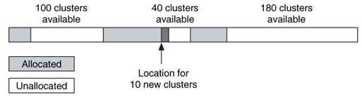
Cluster Allocation Algorithms
an allocation strategy is OS-dependent, and different implementations of NTFS may use different strategies.
For example, Windows XP uses the best-fit algorithm.
  The best-fit algorithm is when the data is placed in a location that will most efficiently use the available space, even if it is not the first or next available. Therefore, if a small amount of data is being written, it will be placed in clusters that are part of a small group of unallocated clusters instead of in a large group where larger files could be stored.
Example,
  Figure shows a scenario where we need to allocate 10 clusters for a file.
  There are three chunks of unallocated clusters.
  The first chunk is from cluster 100 to 199, the second is from cluster 280 to 319, and the third is from cluster 370 to 549.
  The best-fit algorithm would allocate clusters 280 to 289 for the new file because that is in the smallest available group of clusters that the file can fit.
Notes:
Best-fit algorithm is very complicated compared to next-fit and introduces additional overhead and tracking of the holes (chunks of available memory).
Can use a hash table and binary tree → use hash table to match key of a hole; if allocation size needed does not fit exactly then we can use binary search tree to find the next closest size that will match a key.

Slide 41
MFT Entry Attribute Concepts
An MFT entry has little internal structure and most if it is used to store attributes.
Attribute: A data structures that store a specific type of data.
Attribute Types: There are many types of attributes, and each has its own internal structure.
For example: attributes for a file's name, date and time, and file contents.
This makes NTFS is very different from other file systems.
  For example, most file systems exist to read and write file content, but NTFS exists to read and write attributes, one of which happens to contain file content.

Slide 42
Example
Imagine an MFT entry as a large box that is initially empty.
Attributes are similar to smaller boxes inside the larger box where the smaller boxes can be any shape that most efficiently stores the object.
For example,
  a hat can be stored in a short-round box, and
  a poster can be stored in a long-round box.

Slide 43
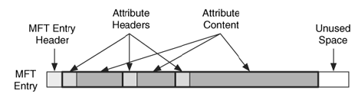
Attribute Layout
Each type of attribute stores a different type of data.
All attributes have two parts: the header and the content.
Figure below shows an MFT entry with four header and content pairs.
  The header is generic and standard to all attributes.
  The content is specific to the type of attribute and can be any size.
  If we think of our boxes analogy, there is always the same basic information on the outside of each small box, but the shape of each box may be different.

Slide 44
Attribute Header
The attribute header identifies attribute type, size, and name.
It also has flags to identify if the value is compressed or encrypted.
Attribute type: is a numerical identifier based on the data type and the default attribute is in the "Standard Attribute" section.
Multiple Attributes: An MFT entry can have multiple attributes of the same type.
Attribute Name: Some of the attributes can be assigned a name and it is stored in UTF-16 Unicode in the attribute header.
Unique MFT entry identifier: An attribute also has an identifier value assigned to it that is unique to that MFT entry.
  If an entry has more than one attribute of the same type, this identifier can be used to differentiate between them.
Notes:
Note: name of an attribute is different from the type; so you do not have the name (of the type) an attribute with a name that corresponds to its actual type.
Typically, encryption is used for data attributes.

Slide 45
Attribute Content
The content of the attribute can have any format and any size.
  For example, one of the attributes is used to store the content for a file, so it could be several MB or GB in size (would require larger MFT entry sizes, which would cause inefficiency).
  It is not practical to store this amount of data in an MFT entry, which is only 1,024 bytes.
To solve this problem, NTFS provides two locations where attribute content can be stored.
  A resident attribute stores its content in the MFT entry with the attribute header. This works for only small attributes.
  A non-resident attribute stores its content in an external cluster in the file system.
The header of the attribute identifies if the attribute is resident or non-resident.
  If an attribute is resident, the content will immediately follow the header.
  If the attribute is non-resident, the header will give the cluster addresses.
  In Figure illustrate the example MFT entry that we saw previously, but now its third attribute is too large to fit in the MFT, and it has allocated cluster 829.

Slide 46
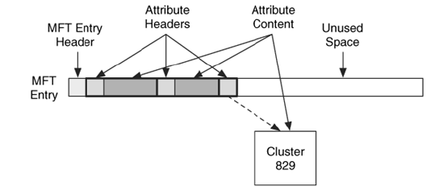
Resident vs Non-resident Attribute

Slide 47
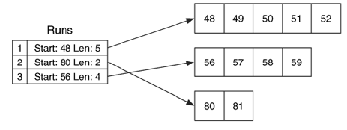
Non-resident Attributes
Non-resident attributes are stored in cluster runs, which are consecutive clusters, and a cluster run is documented using the starting cluster address and the run length.
Example:
  Consider an attribute that has allocated clusters 48, 49, 50, 51, and 52, it has a run that starts in cluster 48 with a length of 5.
  If the attribute also allocated clusters 80 and 81, it has a second run that starts in cluster 80 with a length of 2. A third run could start at cluster 56 and have a length of 4.
Notes:
Files are often fragmented, but often not very fragmented → usually is composed of only a few very long (contiguous) fragments.
Thus, we can do cluster runs (using a number to say how many clusters after starting cluster of a fragment runs) since most data of a file is contiguous.
EXAMPLE of VCN-LCN 1:1 mapping (from slide 47 → non-resident attribute cluster runs) (this information is stored in MFT entry; would not be efficient if files were fragmented into many, many non-contiguous segments)
LCN VCN
48 0
49 1
50 2
51 3
52 4
80 5
81 6
56 7
57 8
58 9
59 10

Slide 48
Resident vs Non-Resident Attributes
A resident attribute stores its content in the MFT entry
A non-resident attribute stores its content in external clusters
Non resident attributes are stored in cluster runs
The attribute header gives the starting cluster address and its run length

Slide 49
Logical Cluster Number (LCN) & Virtual Cluster Number (VCN)
Difference between the different types of addressing methods.
  For example, the logical file system address as the address assigned to file system data units and the logical file address as relative to the start of a file.
In NTFS different terms are used for these addressing methods , that is,
  The Logical Cluster Number (LCN) is the same as the logical file system address, and the Virtual Cluster Number (VCN) is the same as a logical file address.
NTFS uses VCN-to-LCN mappings to describe the non-resident attribute runs.
  Consider, for example, the previous example, this attribute's run shows that VCN addresses 0 to 4 map to LCN addresses 48 to 52, VCN addresses 5 to 6 map to LCN addresses 80 to 81, and VCN addresses 7 to 10 map to LCN addresses 56 to 59.
  The runlist data structure is given in the "Attribute Header".
Notes:
EXAMPLE of VCN-LCN 1:1 mapping (from slide 47 → non-resident attribute cluster runs) (this information is stored in MFT entry; would not be efficient if files were fragmented into many, many non-contiguous segments)
LCN VCN
48 0
49 1
50 2
51 3
52 4
80 5
81 6
56 7
57 8
58 9
59 10

Slide 50
Standard Attribute Types
The standard attributes have a default type value assigned to them, it can also be be redefined in the $AttrDef file system metadata file.
In addition to a number, each attribute type has a name, and it has all capital letters and starts with "$."
Some of the default attribute types and their identifiers are given in the Table next.
Not all these attribute types and identifiers will exist for every file.
Note: Microsoft sorts the attributes in an entry using default type value.

Slide 51
List of default MFT entry attribute types
Type Identifier | Name | Description
16 | $STANDARD_INFORMATION | General information, such as flags; the last accessed, written, and created times; and the owner and security ID.
32 | $ATTRIBUTE_LIST | List where other attributes for file can be found.
48 | $FILE_NAME | File name, in Unicode, and the last accessed, written, and created times.
64 | $VOLUME_VERSION | Volume information. Exists only in version 1.2 (Windows NT).
64 | $OBJECT_ID | A 16-byte unique identifier for the file or directory. Exists only in versions 3.0+ and after (Windows 2000+).
80 | $SECURITY_ DESCRIPTOR | The access control and security properties of the file.
96 | $VOLUME_NAME | Volume name.
112 | $VOLUME_ INFORMATION | File system version and other flags.
128 | $DATA | File contents.
144 | $INDEX_ROOT | Root node of an index tree.
160 | $INDEX_ALLOCATION | Nodes of an index tree rooted in $INDEX_ROOT attribute.
176 | $BITMAP | A bitmap for the $MFT file and for indexes.
192 | $SYMBOLIC_LINK | Soft link information. Exists only in version 1.2 (Windows NT).
192 | $REPARSE_POINT | Contains data about a reparse point, which is used as a soft link in version 3.0+ (Windows 2000+).
208 | $EA_INFORMATION | Used for backward compatibility with OS/2 applications (HPFS).
224 | $EA | Used for backward compatibility with OS/2 applications (HPFS).
256 | $LOGGED_UTILITY_STREAM | Contains keys and information about encrypted attributes in version 3.0+ (Windows 2000+).
Notes:
The file where the data for attribute types and their definitions are in the $AttrDef system file; there can be 2^16 types of attributes; as you see above, there are only about 20 attributes defined/used and has a lot of room for future expansion; upon adding a new type of attribute and its definition, simply implement it in the $AttrDef system file to add it.

Slide 52
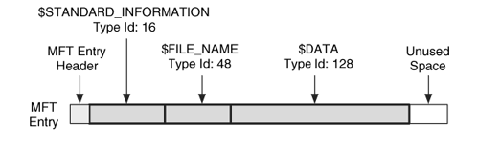
Standard Attribute Type: Example
Consider the following MFT entry with its names and types.
It has the three standard file attributes. In this example, all the attributes are resident.

Slide 53
Base MFT Entries
The 16-bit identifier can support up to 65,536 file attributes, so it may need more than one MFT entry to store all the attribute headers (even non-resident attributes need their header to be in the MTF entry).
When additional MFT entries are allocated to a file, the original MFT entry becomes the base MFT entry.
The non-base entries will have the base entry's address in one of their MFT entry fields.
The base MFT entry will have an $ATTRIBUTE_LIST type attribute that contains a list with each of the file's attributes and the MFT address in which it can be found.
The non-base MFT entries do not have the $FILE_NAME and $STANDARD_INFORMATION attributes in them.

Slide 54
File System Layout
The NTFS file system does not have strict layout requirements, but Windows formats the file system using some general guidelines.
The layout is different for most versions of NTFS, but there are some basic concepts.
One basic concept for all versions of NTFS is the MFT Zone.
  Windows creates the MFT as small as possible and expands it only when more entries are needed. Therefore, there is a risk that it could easily become fragmented if the space after the MFT is allocated to a file.
  To prevent this, Microsoft reserves part of the file system for the MFT.
  The MFT Zone is a collection of consecutive clusters that are not used to store file or directory content unless the rest of the disk is full.
  By default, Microsoft allocates 12.5% of the file system to the MFT (to reduce chance that MFT table is fragmented). If the rest of the file system fills up, the MFT Zone will be used.
Notes:
Remember, all space on a NTFS drive is file content → including meta data which is stored in $ (system) files, and MFT table is also stored in a file. So, all space on the drive is file content.

Slide 55
File System Layout
All versions of NTFS and Windows allocate the first clusters to the $Boot file.
Windows NT and 2000 allocated its file system metadata files right after the $Boot file and in the middle of the file system.
For example, if a file system had a 1 KB cluster size, the first eight clusters would be allocated to the $Boot file, and the clusters for the $MFT file may start in cluster 16 or 32.
The MFT Zone would extend for the next 12.5% of the file system.
The middle cluster in the file system would be allocated to the $MFTMirr file and the remainder of the file system metadata files, such as $LogFile, $Root, $Bitmap, and $Upcase, would follow.
One difference that has been observed between Windows NT and 2000 is that NT places the $AttrDef file in the latter part of the file system, but Windows 2000 places it before the $MFT file.
Notes:
For example, if you have a disk size of 1GB, then the $MFTMirr file (a system file, denoted by $ symbol) would be at the 512MB location.

Slide 56
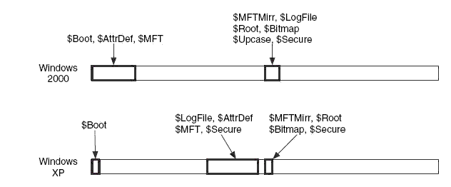
File System Layout
It has been noted that Windows XP moves some of the data to the one-third point in the file system.
  The $LogFile, $AttrDef, $MFT, and $Secure files allocated clusters at one-third of the way through the file system.
  The other file system metadata files were located one-half of the way through the file system.
Only the $Boot file is located in the first few clusters of the file system.
All the clusters in between the file system metadata files can be allocated to user files and directories.
Figure shows the locations where different file system metadata files are located when formatted by Windows 2000 or XP.

Slide 57
Analysis Techniques
Analysis of the content category involves
  locating a specific cluster,
  determining its allocation status, and
  processing the content in some fashion.
Finding a specific cluster is easy because the first cluster is at the start of the file system, and the cluster size is given in the first sector (cluster 0 is at the beginning of the partition (volume).
The allocation status of a cluster is determined by locating the $Bitmap file and processing its $DATA attribute.
  Each bit in the attribute corresponds to a cluster in the file system.
A common analysis technique is to extract the unallocated space of a file system.
  For example, in case of NTFS, examine the $Bitmap file, and extract the contents of each cluster with a 0 bit. All NTFS file system administrative data are located in a file, so none of it should be considered unallocated data during this process.

Slide 58
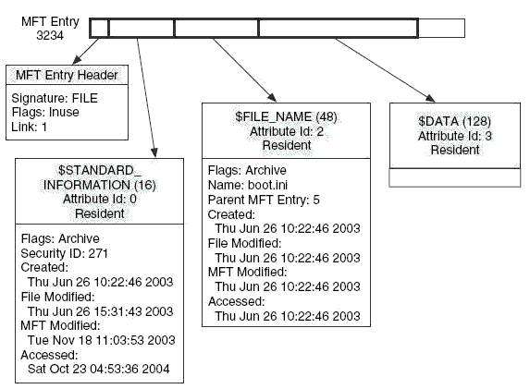
Metadata Category
The metadata category includes data that describes a file or directory.
All metadata is stored in one of the attributes, so we will now look at details of the file attributes.
To review, a typical file has a $STANDARD_INFORMATION, a $FILE_NAME, and a $DATA attribute.
A typical file that has the standard attributes shown as,
Notes:
Notice filename attribute redundantly contains the time stamps that a standard information attribute has.
Easy to trace back to parent (instead of doing tree calculation) because $filename attribute contains a pointer to parent MFT entry.
Can use MFT entry header of a MFT Entry to see if it is allocated or not, or you can simply us the MFT entry bitmap.
NTFS allows you to put the same file in more than 1 directory using a hardware link to physical location (address) (not a shortcut, which is a software link) → Link: in MFT entry Header tells you number of links → typically files contain only 1 link to 1 parent.

Slide 59
$STANDARD_INFORMATION Attribute
The $STANDARD_INFORMATION attribute exists for all files and directories and contains the core metadata.
It provides primary as well as exclusive, set of time and date stamps, and you also find ownership, security, and quota information.
Nothing in this attribute is essential to storing files, but many of the application-level features that Microsoft provides depend on it.
The default type ID for this attribute is 16, and it has a static size of 72 bytes in the Windows 2000 and XP versions and 48 bytes in the Windows NT version.
  Microsoft sorts the attributes in an MFT entry, and this one is always first in the entry because it has the lowest type ID.
There are four date and timestamps in this attribute.
NTFS date and time stamps are 64-bit values that represent the number of one-hundred nanoseconds since January 1, 1601 UTC, which is useful if you need to investigate a computer that was used during the eighteenth century.
Notes:
NTFS supports Access Control security attributes under standard information attribute which include: auditing → contains a log of a file to say whenever it is read, written, or executed.
It also contains access control attribute to allow certain users to RWX, and other special permissions.

Slide 60
$FILE_NAME Attribute
Every file and directory has at least one $FILE_NAME attribute in its MFT entry.
In addition, every file and directory has at least one other instance of a $FILE_NAME attribute in the index of its parent directory, although the two instances do not necessarily contain the same data.
The attribute has a type identifier of 48 and a variable length, which depends on the length of the file name.
  The base length is 66 bytes plus the name.
The $FILE_NAME attribute contains the name of the file encoded in UTF-16 Unicode.
The name must be in a specific name space, such as the 8.3 DOS format, Win32 format, or POSIX.
  Windows typically forces a file to have a name in the 8.3 DOS name space, so some files have $FILE_NAME attributes for both the real file name and the DOS version, but this behavior can be disabled. Each name space has different restrictions on what they consider valid characters.
Notes:
UTF-16 = 16 bits to represent 2^16 characters from most major languages around the world (including Asian languages such as Chinese, Japanese, etc.).
Certainly not enough characters for all major languages, so there is a UTF-32 format.
UTF-8 = can represent ASCII code in only 1 byte (8 bits).
UTF-16 thus requires using 16 bits for ASCII encoding even though it does not require that many bits; so UTF-8 is more efficient for encoding ASCII.

Slide 61
$FILE_NAME Attribute
The $FILE_NAME attribute contains the file reference for the parent directory, which is actually one of the most useful values in the attribute when it is located in an MFT entry.
  This allows a tool to identify the full path of a random MFT entry.
This attribute also contains a set of the four temporal values same as recorded in "$STANDARD_INFORMATION Attribute".
  Windows does not typically update this set of temporal values like it does with those in the $STANDARD_INFORMATION attribute, and they frequently correspond to when the file was created, moved, or renamed.
Lastly, this attribute contains a flags field that can identify if an entry is for a directory, read-only, a system file, compressed, encrypted, and so on.
  The same flags that were used in $STANDARD_INFORMATION are included here.
In summary, this attribute contains many values that are duplicated with $STANDARD_INFORMATION. The new values are the name of the file and the address of the parent directory, which can be used to determine the full path.

Slide 62
$DATA Attribute
The $DATA attribute is used to store any form of data—it has no format or defined values.
  Its attribute type identifier is 128, and it can be any size, including 0 bytes.
  One $DATA attribute is allocated for each file, and it does not have a name.
  Additional $DATA attributes can be allocated to an MFT entry, but they must have names.
There are many uses for additional $DATA attributes.
  Some anti-virus and backup software will create a $DATA attribute on files that it has processed.
  Directories can even have a $DATA attribute in addition to their index attributes.
  Additional $DATA attributes can also be used to hide data.
  The additional $DATA attributes are not shown when the contents of a directory are listed; so special tools are needed to locate them.
Some tools, including The Sleuth Kit (TSK) will assign it the name $Data.
Most forensic tools will show the additional $DATA attributes, which are also called alternate data streams (ADS).
Notes:
Additional $data attributes of a file are also called ADS (alternate data streams).

Slide 63
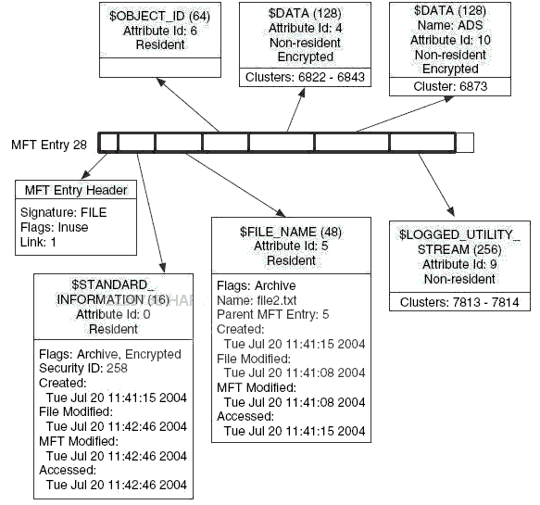
$DATA Attribute

Slide 64
Sparse Attributes
A sparse attribute is one where clusters that contain all zeros are not written to disk. Instead, a special run is created for the zero clusters.
Typically, a run contains the starting cluster location and the size, but a sparse run contains only the size and not a starting location.
There is also a flag that indicates if an attribute is sparse.
Note: NTFS can reduce the space needed by a file by saving some of the non-resident $DATA attribute values as sparse.
Notes:
Used to reduce occupying disk space for when you create large files that are not yet filled with any contents
Especially used with databases.
For example: a 100GB file that only uses 10GB, the other 90GB are not really used and thus also not yet (truly) allocated on the disk.

Slide 65
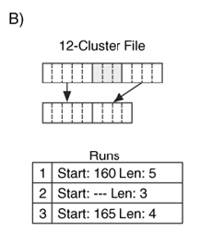
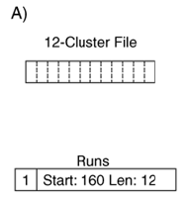
Sparse Attributes: Example
Consider a file that should occupy 12 clusters.
  The first five clusters are non-zero, the next three clusters contain zeros, and the last four clusters are non-zero.
Normal attribute allocation, one run of length 12 may be created for the file, as shown in Figure (A).
Sparse attribute allocation, three runs are created and only nine clusters are allocated, which can be seen in Figure (B).
Notes:
The unused (sparse = zeroed clusters) clusters on the disk can be used for other files; they are not allocated.
For example B), when the file later needs the next 3 of its 12 clusters to be occupied, simply find 3 empty (perhaps even “sparse” attribute clusters from other file’s sparse clusters) clusters on the disk and write to it and add it to the cluster run (at position 2 from the example) for the file.
NOTE: sparse clusters really are just unused (unallocated) clusters of the disk. Logically they are called “sparse” by the sparse flag/attribute of an attribute for a file, but really we only keep track of sparse clusters as clusters that could occupy any empty/unallocated cluster on the disk. This may simply be to track number of sparse clusters in the NTFS system while saving disk space and being able to use that disk space to move contents around and keep the disk efficient space-wise since there can be many files that are allocated many clusters, many of which are all 0s = not being used by the file yet.

Slide 66
Compressed Attributes
NTFS allows attributes to be written in a compressed format
The actual algorithm is not given.
  Note that this is a file system-level compression and not an external application level compression that can be achieved by using zip or gzip.
Only the $DATA attribute should be compressed, and only when it is non-resident.
NTFS uses both sparse runs and compressed data to reduce the amount of space needed.
The attribute header flag identifies whether it is compressed, and the flags in the $STANDARD_INFORMATION and $FILE_NAME attribute also show if the file contains compressed attributes.

Slide 67
Compressed Attributes
Before compression, the data are broken up into equal sized chunks called compression units.
The size of the compression unit is given in the attribute header.
Following three scenarios occur with each compression unit:
  All the clusters contain zeros, in which case a run of sparse data is made for the size of the compression unit and no disk space is allocated.
  When compressed, the resulting data needs the same number of clusters for storage (i.e., the data did not compress much). In this case, the compression unit is not compressed, and a run is made for the original data.
  When compressed, the resulting data uses fewer clusters. In this case, the data is compressed and stored in a run on the disk. A sparse run follows the compressed run to make the total run length equal to the number of clusters in a compression unit.
Notes:
Each compression unit goes through the compression algorithm and depending on its content each unit compresses to its various respective sizes (the output of the algorithm) → the algorithm is a function, so for each unique input of data, you get a unique output of compressed data.

Slide 68
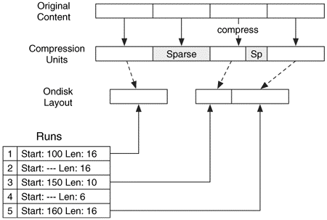
Compressed Attribute: Example
Assume that the compression unit size is 16 clusters and we have a $DATA attribute that is 64 clusters in length, as shown in Figure.
Divide the content into four compression units and examine each.
  The first unit compresses to 16 clusters, so it is not compressed.
  The second unit is all zeros, so a sparse run of 16 clusters is made for it, and no clusters are allocated.
  The third unit compresses to 10 clusters, so the compressed data is written to disk in a run of 10 clusters, and
  A sparse run of six clusters is added to account for the compressed data.
  The final unit compresses to 16 clusters, so it is not compressed and a run of 16 clusters is created.

Slide 69
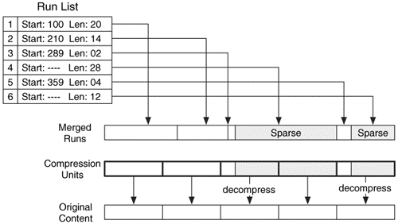
Compressed Attribute: Example 2
What if the layout of the previous attribute compression is not initially organized using compression units?
  To process this file, we need to first organize all the data in the six runs and then organize the data into compression units of 16 clusters.
  After merging the fragmented runs, we see that there is one run of content, one sparse run, more content, and another sparse run.
    The merged data are organized into compression units, and we see that the first two units have no sparse runs and are not compressed.
    The third and fifth units have a sparse run and are compressed.
    The fourth unit is sparse, and the corresponding data are all zeros.
Notes:
Reversing the process of compression (decompression algorithm) is very time consuming (a lot of overhead).
So there is a time-space tradeoff → compression saves space but it costs time.
Notice in the example, one of the segments is entirely grayed out (as it is part of sparse clusters) thus the diagram is just showing logically that the 16 sparse clusters compressed to 0 clusters (since all 16 clusters were just all zeroes) and thus when the 0 compressed clusters are decompressed then it occupies 16 sparse clusters.

Slide 70
Attribute Encryption
Windows allows only $DATA attributes to be encrypted.
  When an attribute is encrypted, only the content is encrypted and the attribute header is not.
A $LOGGED_UTILITY_STREAM attribute is created for the file, and it contains the keys needed to decrypt the data.
An encrypted file or directory has a special flag set in the $STANDARD_INFORMATION attribute, and each attribute that is encrypted will have a special flag set in its attribute header.
The contents are encrypted with a symmetric algorithm called DESX.
  One random key is generated for each MFT entry with encrypted data, and it is called the file encryption key (FEK).
  If there are multiple $DATA attributes in the MFT entry, they are all encrypted with the same FEK.
Notes:
Symmetric key algorithm → encryption and decryption are using the same key → encryption key == decryption key.

Slide 71
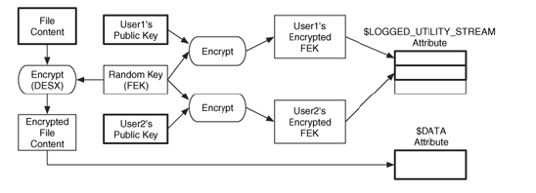
Attribute Encryption: NTFS Implementation
Notes:
The key is randomly generated; each encrypted file has its own key; this key must be stored somewhere in the NTFS system somehow (done via user’s public key) (on the disk volume where the NTFS file system is being implemented).
File can be shared and encrypted among multiple users.
User’s public key used to encrypt the FEK random key and store the key in the logged_utility_stream attribute.
FEK used to encrypt the data, public key used to encrypt the FEK key.
Public key = 1000x slower than symmetric key algorithm and is asymmetric, but this is okay because it is only used to encrypt the FEK key.
All user’s have their own Public and Private keys (one for encryption, the other for decryption; the keys are inverses of each other) → encryption key == inverse(decryption key).
In this scenario, the private key is used to do digital signature (since if you sign with a private key that only you have, thenthose with the correct public key can decrypt it and know that it was signed by private key since it was able to be decrypted with that public key) and also to access the logged_utility_stream file to decrypt the encrypted FEK key.
Not only is the FEK encrypted by the user who has permissions to the file, but if that user wants to give access to other users, it gives them the public key so they can also encrypt FEK key; this is also stored in the logged_utility_stream attribute.
3 types of algorithm:
1) public (and private) key algorithm = slowest because it is asymmetric
2) symmetric key algorithm = faster than public key
3) message digest = fastest (such as MD5 sum and SHA).

Slide 72
Attribute Decryption
To decrypt a $DATA attribute, the $LOGGED_UTILITY_STREAM attribute contains a list of data decryption fields (DDF) and data recovery fields (DRF).
A DDF is created for every user who has access to the file, and it contains the user's Security ID (SID), encryption information, and the FEK encrypted with the user's public key.
A data recovery field is created for each method of data recovery, and it contains the FEK encrypted with a data recovery public key that is used when an administrator, or other authorized user, needs access to the data.

Slide 73
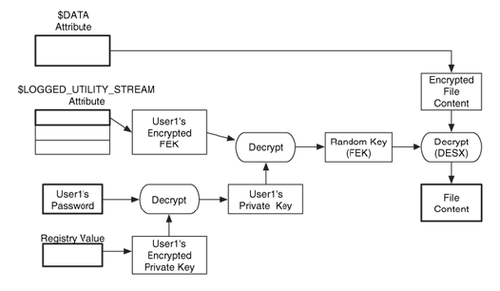
Attribute Decryption: NTFS Implementation

Slide 74
Analysis of Encrypted Attributes
Several security tools can perform a brute force attack against a user's login password, and this can be used to decrypt the data.
Unencrypted copies of file content might also exist in unallocated space if only some directories and files were encrypted.
In fact, there is a small flaw in the NTFS design because it creates a temporary file named EFS0.TMP and it contains the plaintext version of the file being encrypted (it is not wiped after the encryption is done so it may still be in the file system somewhere).
After the OS finishes encrypting the original file, it deletes the temporary file, but the contents are not wiped.
Therefore, a plaintext version of the file exists, and recovery tools might be able to recover the file if its MFT entry has not been reallocated.
The swap space or page file might also provide copies of unencrypted data. It has been reported that if the administrator, domain controller, or other account that is configured as the recovery agent is compromised, any file can be decrypted because that account has access to all files
Notes:
Swap space → virtual RAM memory that is stored on the disk when the RAM gets too full, it can swap RAM memory not being used at the moment to the disk to swap in other memory that is currently needed (so you might have 10GB of RAM, where 8GB is real RAM and the other 2GB of RAM are really denoted by OS and are virtual RAM stored on the disk).

Slide 75
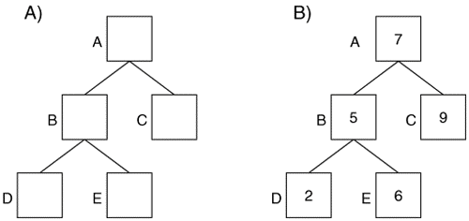
Indexes
Indexes
  An index in NTFS is a collection of attributes that is stored in a sorted order. The most common usage of an index is in a directory because directories contain $FILE_NAME attributes.
B-trees
  An NTFS index sorts attributes into a tree, specifically a B-tree.
  A tree is a group of data structures called nodes that are linked together such that there is a head node and it branches out to the other nodes.(See figure for example: binary tree)
  What’s the difference between binary tree and B-tree?
Notes:
B-tree is a search tree but is more balanced and is very wide tree (not very deep, but very broad = big breadth).
B trees are much more complex but more efficient for searching especially when you have a large number of files.
Remember binary tree only has 1 key and 2 pointers
B trees has m keys and m+1 pointers (this is why the tree can be very wide).
Thus each node of a B tree can store a large number of keys (file names in this case).

Slide 76
B-Tree
In B-tree there can be more than two children per node.
  Typically, the number of children that a node has is based on how many values each node can store.
Notes:
Check CIS-350 Data Structures course with Dr. Guo where he goes over B trees. Also check CIS-200.
Complexity is O[(log_m)(n)], where n is total number of keys, m is number of keys per node.

Slide 77
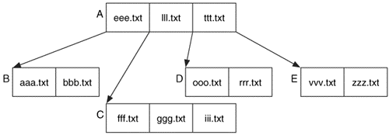
B – Tree: Example
How to locate file name “ggg.txt” ?
Notes:
B Tree = balanced binary search tree (algorithm makes the tree self balancing)
Every node is 1 disk block (4KB) so that you can store a large number of names.
Remember each node is just a file name attribute (stored in file name attribute and also in directories in the B-Tree).
m = # of keys
Number of pointers = m+1
Only time height of tree increases is when the root node needs to be split.
Split is necessary when an additional node is added that causes tree to become out of balance (number of leaves > m for a given node, then split it).
In B tree, all leaf nodes are always on the same level.

Slide 78
B – Tree: Example
How to add file name “jjj.txt” in the following tree?

Slide 79
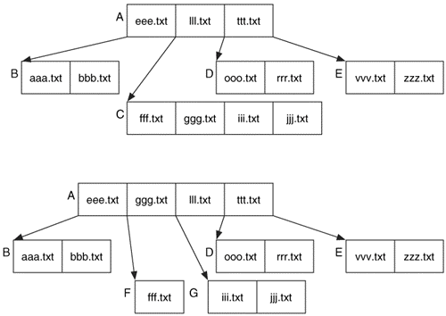
B – Tree: Example
The top tree shows 'jjj.txt' added to node C, and the bottom tree is the result of removing node C because each node can have only three names.

Slide 80
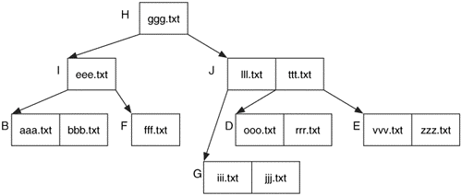
B – Tree: Example
The final state from adding the 'jjj.txt' file

Slide 81
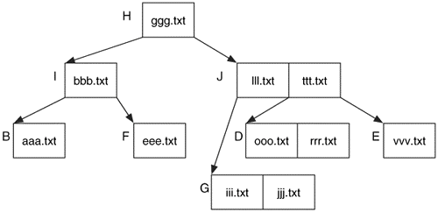
B – Tree: Example
Tree after deleting the 'zzz.txt' file and the 'fff.txt' file.

Slide 82
NTFS Index Attribute
Each entry in the tree uses a data structure called an index entry to store the values in each node.
  There are many types of index entries, but they all have the same standard header fields.
The index nodes can be stored in two types of MFT entry attributes.
  $INDEX_ROOT attribute, and
  $INDEX_ALLOCATION attribute.
Notes:
Index root is just a root node on the B-Tree

Slide 83
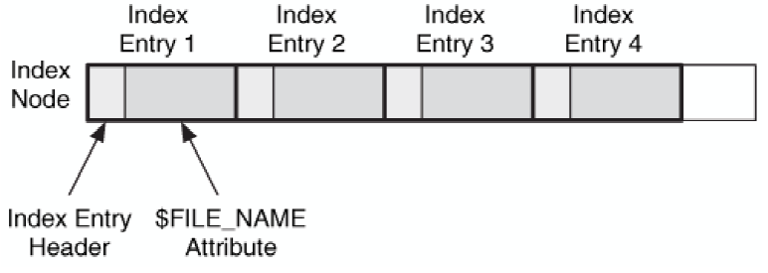
NTFS Index Attribute: Example
Figure shows an example of a node in a directory index with four $FILE_NAME index entries.
Notes:
Time stamps for each file in a directory is part of the index file so that you can see (maybe not accurate) easily the date created and modified of all files in a directory.

Slide 84
$INDEX_ROOT Attribute
The $INDEX_ROOT attribute is always resident and can store only one node that contains a small number of index entries.
The $INDEX_ROOT attribute is always the root of the index tree.

Slide 85
$INDEX_ALLOCATION Attribute
Larger indexes allocate a non-resident $INDEX_ALLOCATION attribute, which can contain as many nodes as needed.
The content of this attribute is a large buffer that contains one or more index records.
An index record has a static size, typically 4,096 bytes, and it contains a list of index entries.
Each index record is given an address, starting with 0.
Notes:
You use the Index Allocation attribute to access all of the nodes of the B tree.

Slide 86
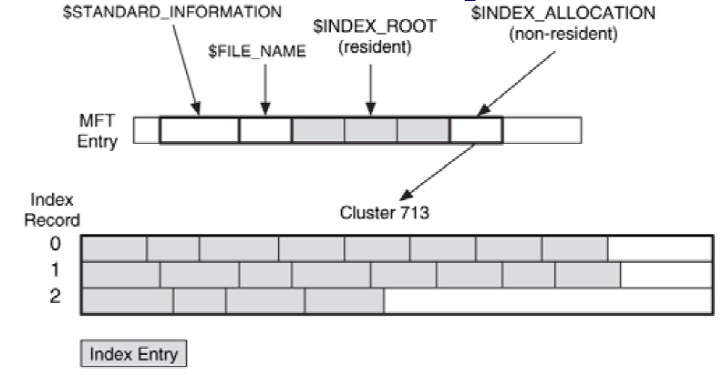
Example
Consider a directory that has three index entries in its resident $INDEX_ROOT attribute and three index records in its non-resident $INDEX_ALLOCATION attribute.
Notes:
If directory is small enough (not that many files in the directory), then it can be stored resident in the MFT entry inside the INDEX ROOT attribute
Otherwise, if number of files too large, then stored in non resident location in the INDEX_ALLOCATION attribute.

Slide 87

NTFS Indexes: Example 1
Consider an index with three entries that fit into $INDEX_ROOT.
  In this case, only a $INDEX_ROOT is allocated, and it contains three index entry data structures and the empty entry at the end of the list. This can be seen in Figure (A).

Slide 88
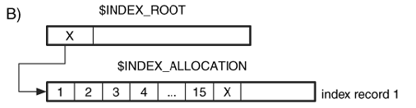
NTFS Indexes: Example 2
Now consider an index with 15 entries, which do not fit into an $INDEX_ROOT but fit into an $INDEX_ALLOCATION attribute with one index record. It can be seen in Figure (B).
Notes:
Each index record is typically 4 KB.
INDEX_ALLOCATION is essentially where the B-Tree is stored.

Slide 89
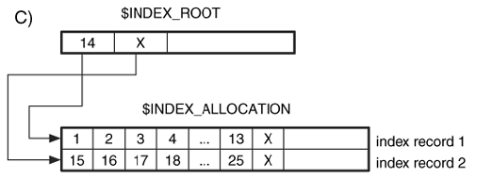
NTFS Indexes: Example 3
After we fill up the index entries in the index record, we need to add a new level, and we create a three-node tree. This scenario is shown in Figure (C).
This has one value in the root node and two children nodes. Each child node is located in a separate index record in the same $INDEX_ALLOCATION attribute, and it is pointed to by the entries in the $INDEX_ROOT node.
Notes:
Record 1 is below 14, record 2 is above 14, as shown, while 14 is inside of the INDEX_ROOT attribute resident in the MFT entry.
Inside each node, remember, is just the file name; and also since B tree is a binary tree, it is very fast and efficient to search for a file inside of a directory.
Complexity O(log_m(N)) instead of O(N) with a list linear search.
Note: B tree cost more time to add or move around files in a directory, but that time cost up front is why later searching the directory is faster and more efficient especially if you do not need to change or add to the directory that often and it is mainly static.
Note: directory files are logical; all files are on the same disk = root; but directory files help to organize files by keeping track of them in groups so that it is easy to search for files.

Slide 90
Analysis Tools
Imagging tools:
  dd
TSK allows you to view the contents of any attribute.
Instead of specifying only the metadata address, use icat tool with the address and the attribute type.
If there is more than one attribute of that type, use unique identifier.
For example,
  if we are examining MFT entry 34, we can see its $FILE_NAME attribute (type 48) by specifying '34-48.'
  If we want to view its $DATA attribute (type 128), we specify '34-128.' If there are multiple $DATA attributes, we also specify the unique attribute identifier.
  If the attribute we want has an ID of 3, we specify '34-128-3.‘
The istat tool in TSK lists all the attributes for a file.

Slide 91
Creating an NTFS File
e.g.: Creating dir1\file1.txt
Read volume boot sector to locate MFT.
Read first entry in MFT to determine layout of MFT.
Allocate an MFT entry for the new file.
Initialize MFT entry with $STANDARD_INFORMATION, etc.
Check MFT $Bitmap to find free clusters, using best-fit algorithm.
Set corresponding $Bitmap bits to 1.
Write file content to clusters and update $DATA attribute with starting address of cluster run and run length.
Read root directory (MFT entry 5), traverse index, and find dir1.
Read $INDEX_ROOT attribute for dir1 and determine where file1.txt should go.
Create new index entry; resort index tree.
Enter steps in $LogFile (as each step is taken).
Notes:
Notice high upfront cost because of B tree method and all of the other steps to creating a file; but searching later for file contents is faster and NTFS has a lot of flexibility for future additions.
Also: system can crash during this process; so we need to put each of the above steps in the $LogFile so if system crashes we can look at the journal (log) file to roll back (undo) or roll forward and finish he process and commit to the changes so that in one way or another system can return to a consistent state very fast (bit map, etc, is accurate and up to date).
This recovery process if very fast because of the LogFile.

Slide 92
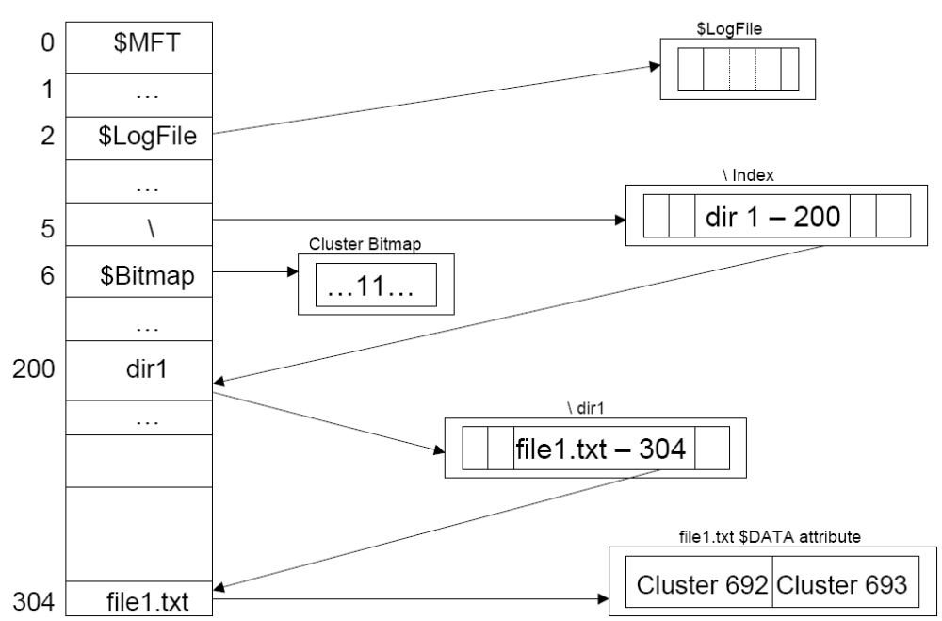
An NTFS Creation File

Slide 93
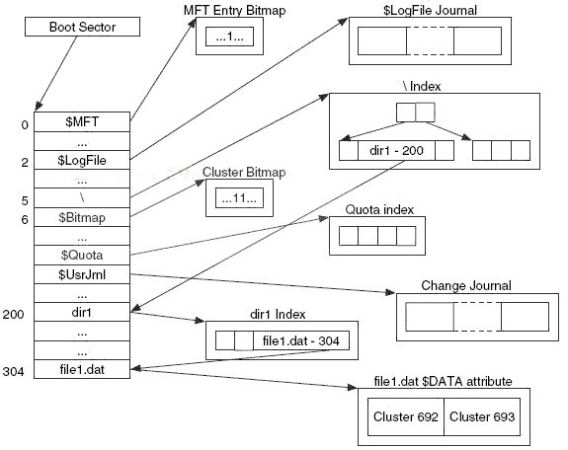
File Allocation Example
Notes:
$Usrjrnl is used by utility programs that is useful for those utility tools to make changes/updates to necessary files.

Slide 94
Deleting an NTFS File
e.g.: Deleting dir1\file1.txt
Read volume boot sector to locate MFT.
Read first entry in MFT to determine layout of MFT.
Read root directory (MFT entry 5), traverse index, and find dir1.
Read $INDEX_ROOT for dir1 entry and find file1.txt entry.
Remove filename entry from index; move other entries over.
Set MFT $Bitmap entries to 0.
Enter steps in $LogFile (as each step is taken).
Notes:
Remember: $LogFile is used to keep the file system consistent (bitmaps, etc. are accurate) so that during crashes system can recover and commit or rollback transactions.

Slide 95
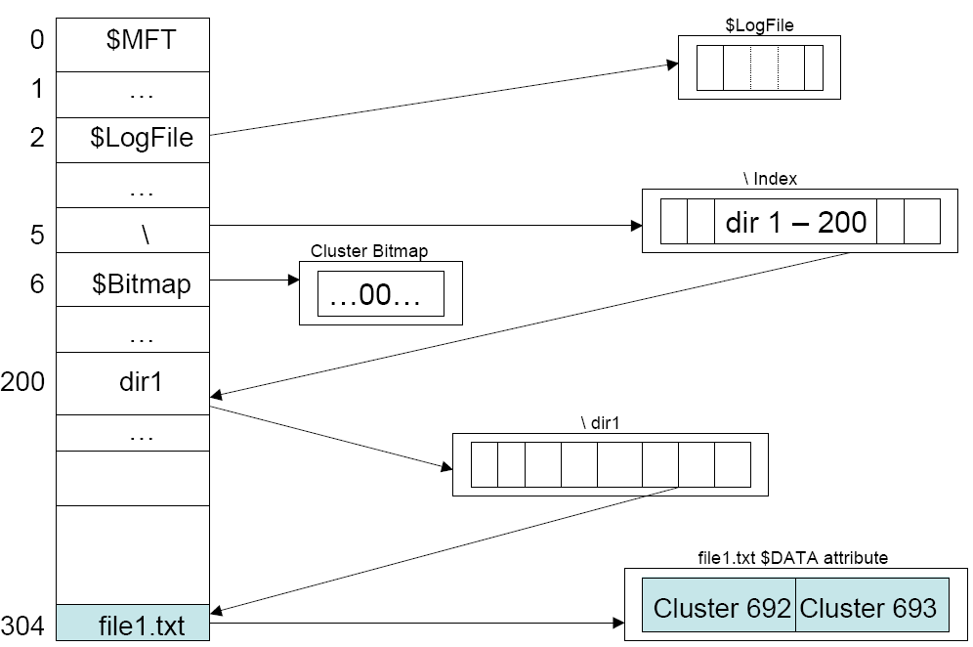
NTFS File Deletion
Data in boxes is unallocated

Slide 96
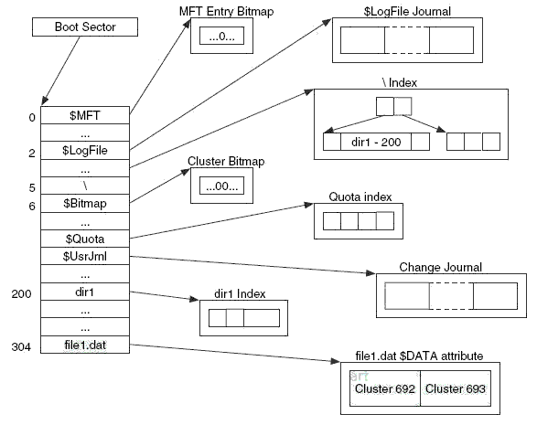
File Deletion Example

